Slide 1



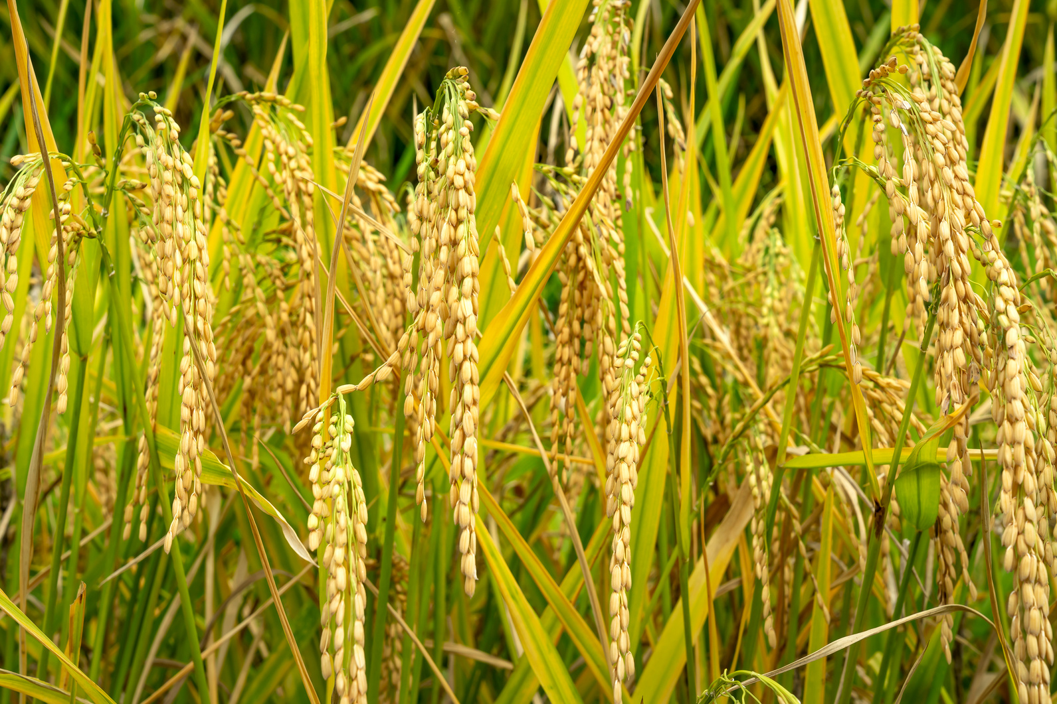



Background
1 Day Workshop
On
SILVER YEARS OF UBKV RESEARCH: ACHIEVEMENTS AND WAY FORWARD
25 Years of UBKV Brilliance: Harvesting Achievements, Sowing the Future
Uttar Banga Krishi Viswavidyalaya (UBKV), in its 25th year, continues to advance agriculture in North Bengal through region-specific crop development, climate-smart technologies, and impactful extension initiatives. Its students have contributed meaningfully through rigorous research, field experimentation, and evidence-based innovations. Moving forward, UBKV remains committed to strengthening climate-resilient agriculture, digital technologies, and sustainable bio-resource management to support a future-ready farming ecosystem.
7th January 2026
Organized by
Cooch Behar Association for
Cultivation of Agricultural Sciences,
UBKV, Pundibari
CONTACT
Dr. Sumit Chakravarty
(Secretary COBACAS)
In association with
Uttar Banga Krishi Viswavidyalaya
Pundibari- 736 165, District Cooch
Behar, West Bengal, India
+91 9434082687,+91 8250279926
c.drsumit@gmail.com

Slide 2



Registration, Fees & Certificates
Mode of Presentation
Fees can be directly transferred to the society (Acc. Name Cooch Behar Association for Cultivation of Agricultural Sce at account No. 33026323337, bank name State bank of India, UBKV, Pundibari IFSC Code: SBIN0018606 and MICR code 736002527) and send the electronic receipt copy along with the registration form to cobacas2013@gmail.com addressing to the Organizing Secretary.
Registration fees include Silver Jubilee memento, refreshments and working lunch.
Participation certificates will be provided to all the participants.
Best poster award will be given.
Students/ JRF/Alumini-300
Teachers/ Scientists/ SMS-400
Organizing Committee
Invited lectures
Students (PG and Ph. D) Participants are requested to present posters showcasing their thesis findings, implications, and future prospects, demonstrating how their work contributes to and strengthens UBKV’s research excellence.
Patron : Prof. Dr. Debabrata Basu (Vice Chancellor UBKV Pundibari)
Chairman: Prof. Dr. Apurba Chowdhury (Dean PGS & Governing body member COBACAS)
Chairman: Prof. Dr. Prabhat Kumar Pal (President COBACAS and Director Extension Education
(Actg.) UBKV Pundibari)
Secretary: Prof. Dr. Sumit Chakravarty (Department of Forestry, UBKV) ; Prof. Dr. Bidhan Roy, Department of Seed Science and Technology, UBKV)
Time:10:30 am onwards
Venue: Swami Vivekananda Memorial Hall
“Research today, resilience tomorrow”
Last date for registration:
For Poster Presentation (STUDENTS): 5th JAN 2026
Teachers Registration: 6th JAN 2026
Further details
cobacas.org.in

